Slide 1

IoT Auto-Parking System
Under the supervision of
Prof. Dr. Nour El-din Hassan Ismail, Alexandria University

Slide 2
Team members
Alaa Adel Hussien Mohamed Nour
Abdulmaguid Eissa Abdulmaguid
Abdulrahman Gamil
Ehsan Ali Mohamed Elkoumy
Heba Gaber Sayed
Moustafa Mostafa Roushdy
Mahmoud Alaa Zakaria walili
Mohamed Sobhy Mohamed
Rana Mahmoud Moghazy Hassan
Shahd Ahmed Mohamed Elkabbary

Slide 3
Outlines
Introduction
IoT car garage
Mobile application
Self-parking robot
Conclusion and future work

Slide 4
Introduction
SMART PARKING SYSTEM

Slide 5
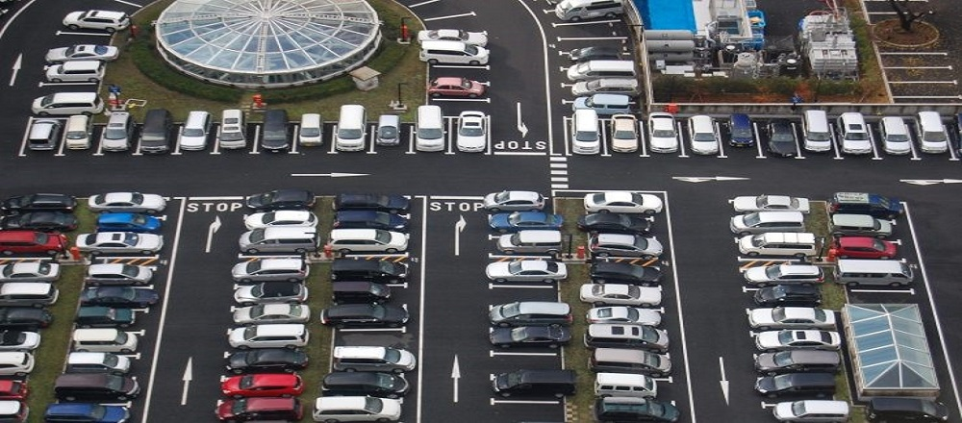
Introduction
Smart parking system (SPS)
Parking problems.
Importance of the SPS.

Slide 6
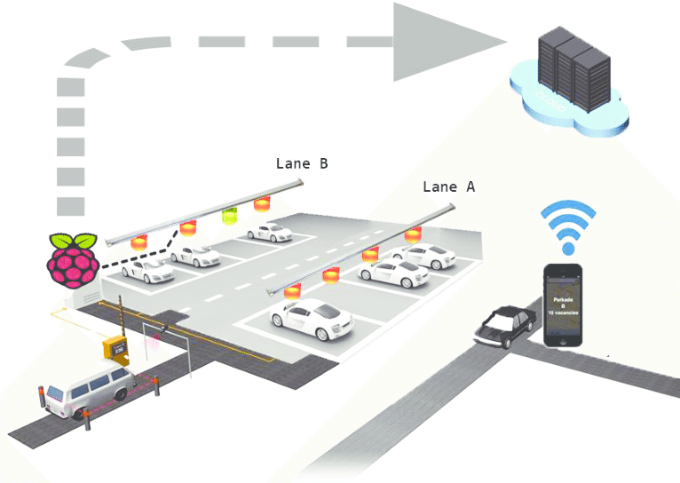
Smart parking system divides into three main parts
Server
Representing the operator side.
Garage system.
Mobile application
Representing the client side.
Checking the availability of the slots.
Sending signal to the car
Self parking robot
Performing parking system automatically.

Slide 7
Implementing a small prototype to represent the complete idea of IoT parking system
Authentication using RFID sensors.
Detection using IR sensors.
Protection procedure using smoke detector sensors.
The Raspberry Pi is responsible for gathering data.
Send this data to the cloud server where it is stored and analysed.
The car receives data from the application and starts the parking process.

Slide 8
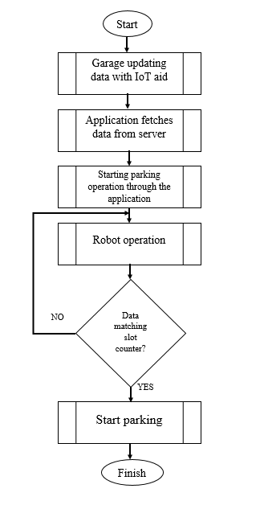
System operation flow graph

Slide 9
IoT Car Garage
GARAGE CONTROLLER USING RASPBERRY PI

Slide 10
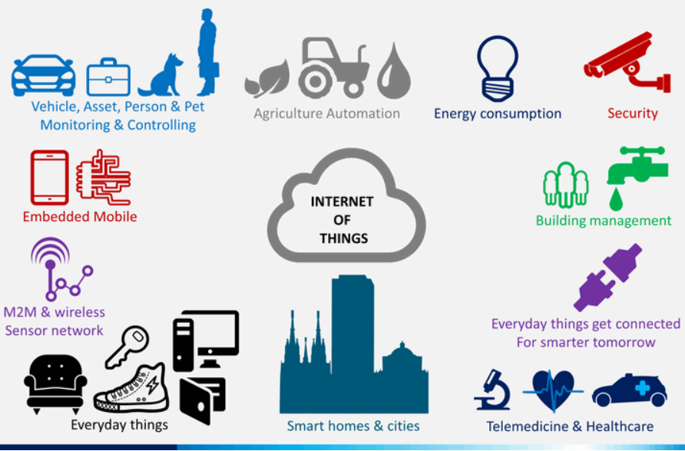
IoT
Machine-to-machine communication
Safety, comfort, efficiency
Better decision making
Save time and money
Security and privacy
Data and complexity

Slide 11
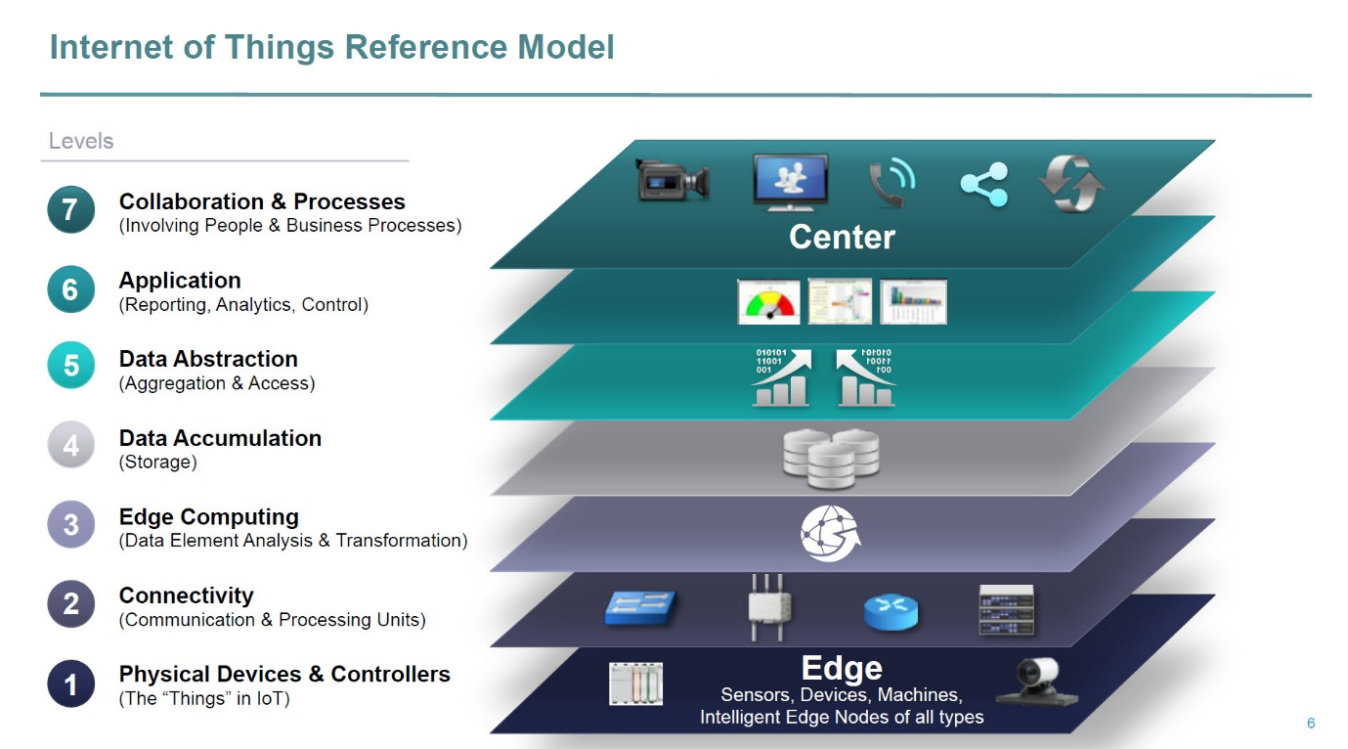
Main important IoT layers
Physical layer
Devices, sensors, controllers.
Edge computing layer
Raspberry Pi acts as a gateway .
Data accumulation
The server and database.
Application layer
Mobile application.

Slide 12
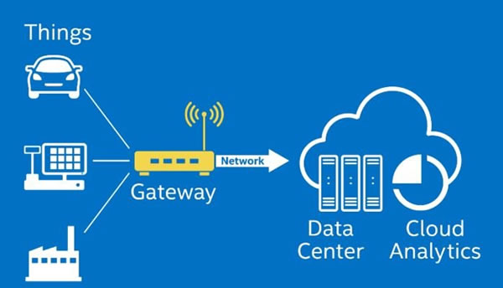
Main IoT parts
Sensors
IR sensors.
RFID sensors.
Gateway
Raspberry Pi.
IoT cloud server
000webhost.

Slide 13
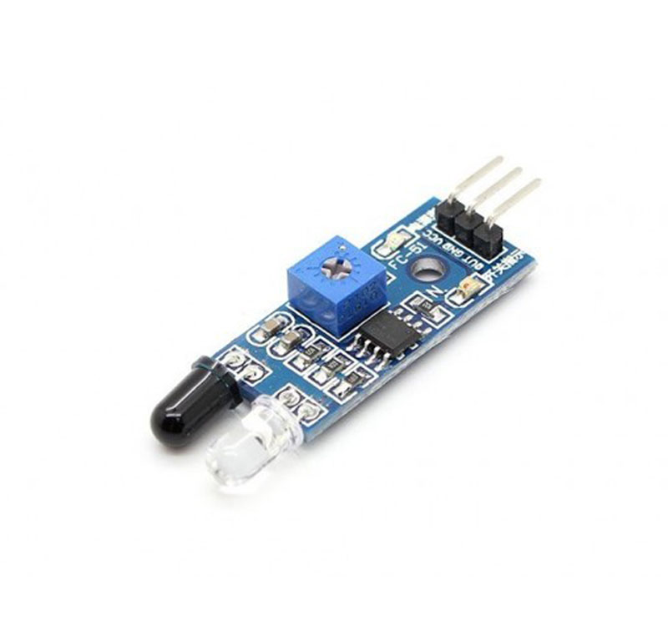
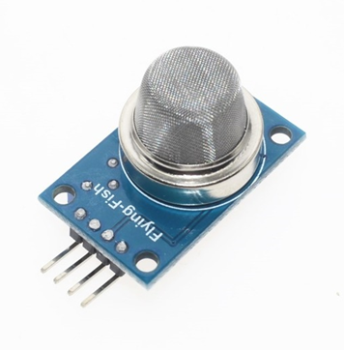
Hardware Pieces
IR sensor
Acts as an object detection sensor.
Detects availability of parking slots.
Smoke detector
Detection of gas leakage.
Protection and fire incident avoidance.
Can figure a sign of fire.

Slide 14
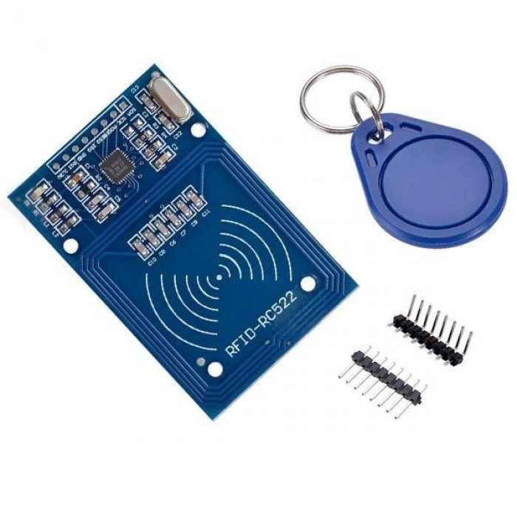
RFID sensor
Method for AIDC.
RFID reader will capture the data stored in the car tag.
This data is any important information about the car and its driver.

Slide 15
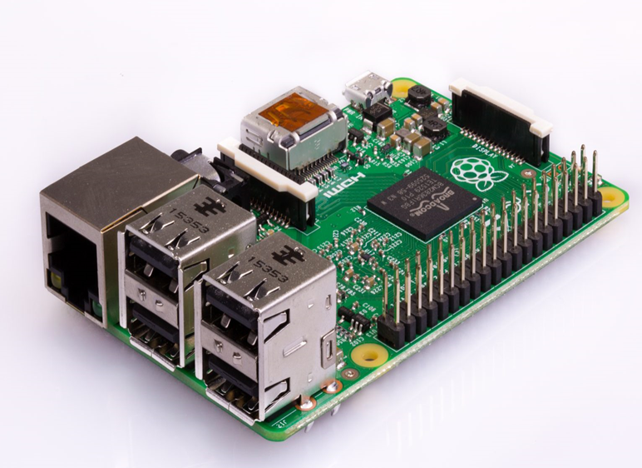
Raspberry Pi
As garage controller.
Take the initial precautions needed in case of fire alarm occurrence.
Handle any required tasks in the operation of the garage.
As IoT gateway
Central data gathering point to which all the data from different sensors
is transmitted .
Do some analytical operation.
Send only the needed important data to the virtual database.

Slide 16
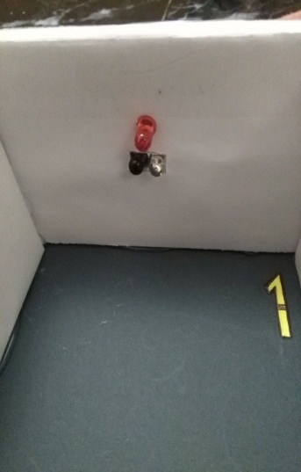
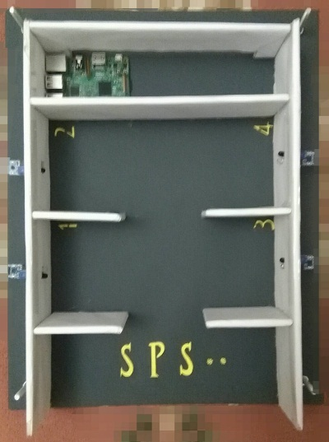
Prototype

Slide 17
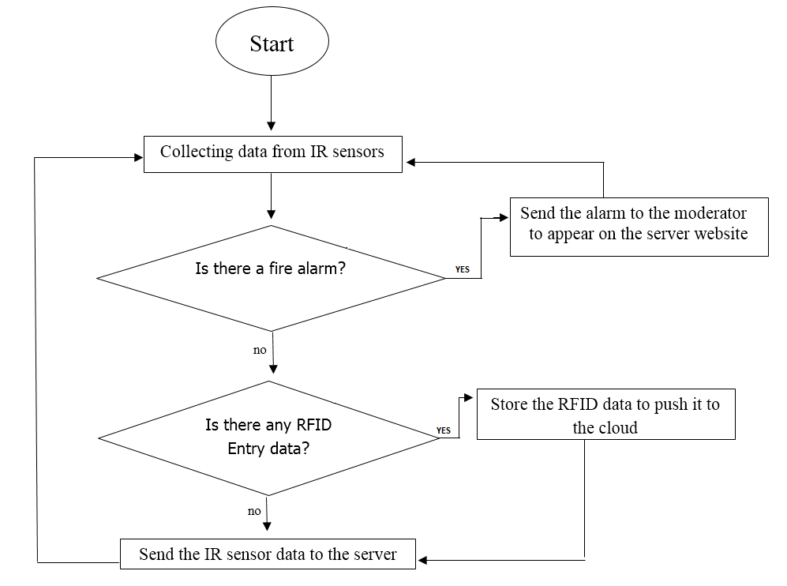
Raspberry Pi software flowchart
Collecting data from IR sensors.
Check if there is fire through smoke detector.
Check if there is any RFID data entry.
Send data from sensors to server.

Slide 18
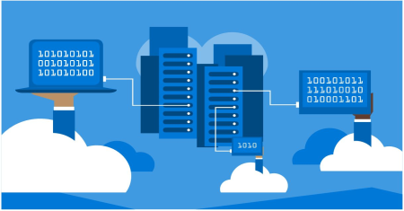
Server and database
Server is a computer, a device or a program that is dedicated to manage network resources.
There are a number of categories of servers, including print servers, file servers, network servers and database servers.
Server often has special characteristics and capabilities, including:
• The ability to update without a restart.
• Advanced backup capability .
• Advanced networking performance.
• Automatic data transfer.
• High security for resources.

Slide 19
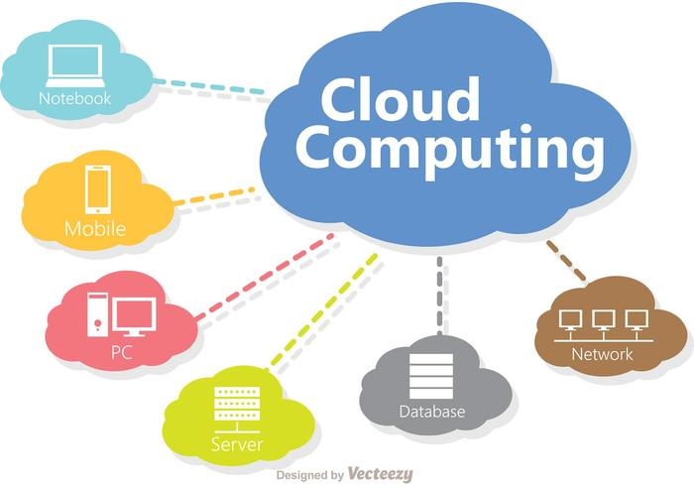
Cloud computing
Elastic resources
Scale up or down quickly and easily to meet demand.
Metered service
So you only pay for what you use.
Increased storage
With the massive Infrastructure that is offered by Cloud.
Data protection
Data recovery and availability
Management capabilities

Slide 20
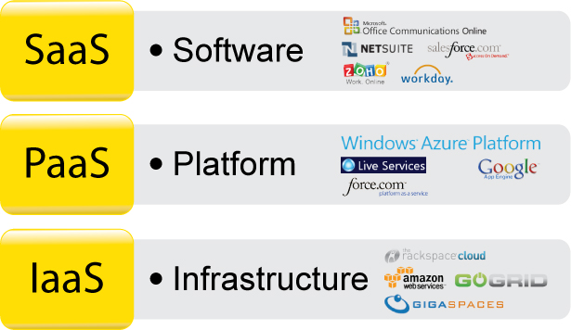
Cloud computing models

Slide 21
In this project, software used
(000webhost) as a free platform which provides the facility to make our own accessible website
accompanied with a dedicated database for data storage.
This website acts as display of the garage for the garage coordinator which monitors
(parking slots state, car info, time since last change and cost of parking)
Act as an alarm display to notify the coordinator of any possibility for a fire to occur.
Data coming from the Raspberry Pi to the server along time, are stored in database.

Slide 22
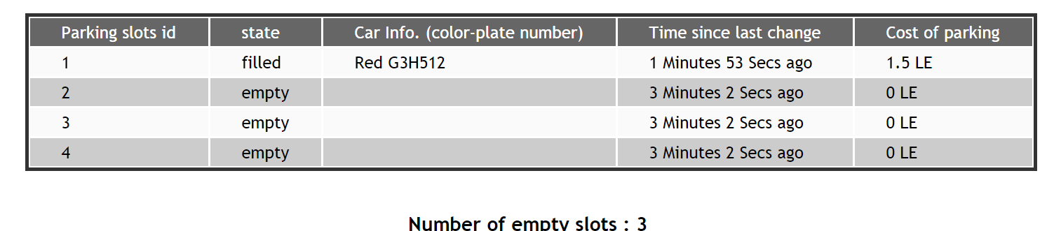
Server
Representation of slots states (empty/filled)

Slide 23
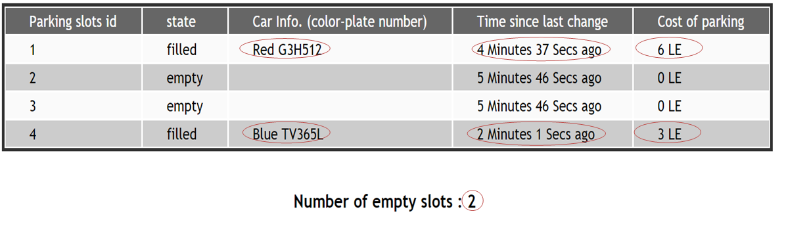
Server
Representation of the parking car information, time spent in the slot and the parking cost

Slide 24
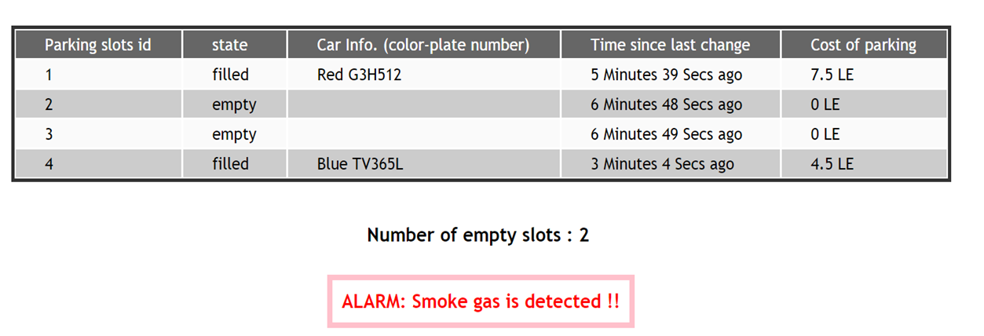
Server
Declaration of fire alarm when a fuel gas is detected

Slide 25
SPS Android Application
APPLICATION DEVELOPMENT

Slide 26
Android
An android application is a mobile software application developed for use on devices powered by Google's Android platform.

Slide 27
Android application software development
- Android SDK
- android studio
- other SDKs

Slide 28
Android development major parts
1- XML (GUI part).
2- Java (Interactive part).

Slide 29
SPS Android Application
“S.P.S using Android application” provides the user an easy way to check the parking slots availability (empty/filled), chooses an empty slot and sends its number to the car to auto-park.

Slide 30
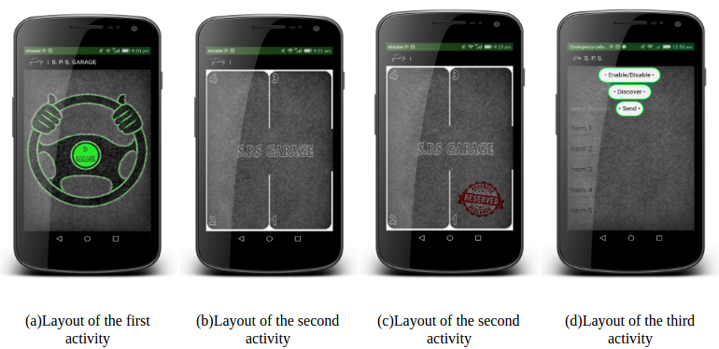
Part one: GUI
Programming procedures

Slide 31
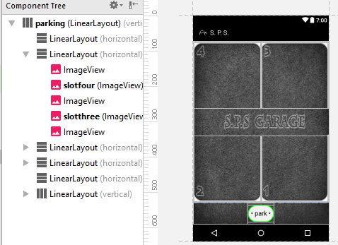
SPS User Interface
Layouts
- Views

Slide 32
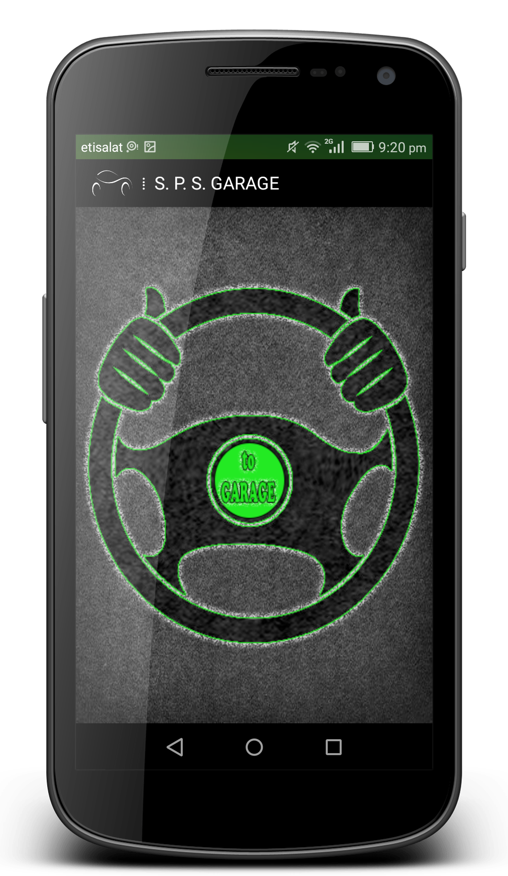
Layout1 (to garage)
- Layout programming procedures.

Slide 33
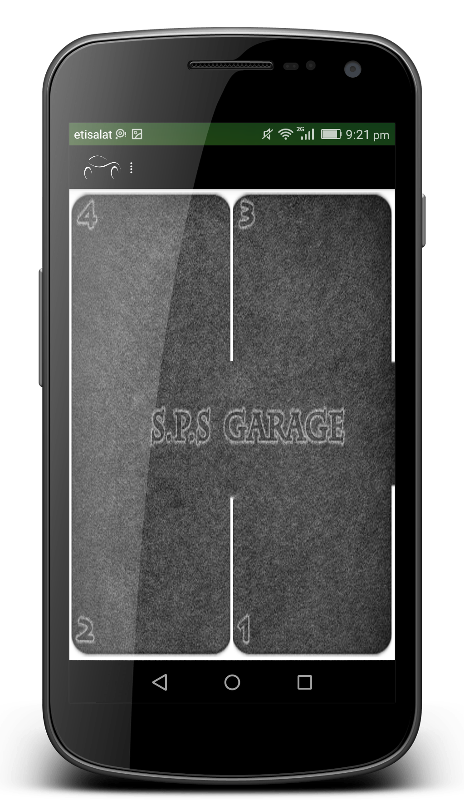
Layout2 (garage simulation)
- Layout programming procedures.

Slide 34
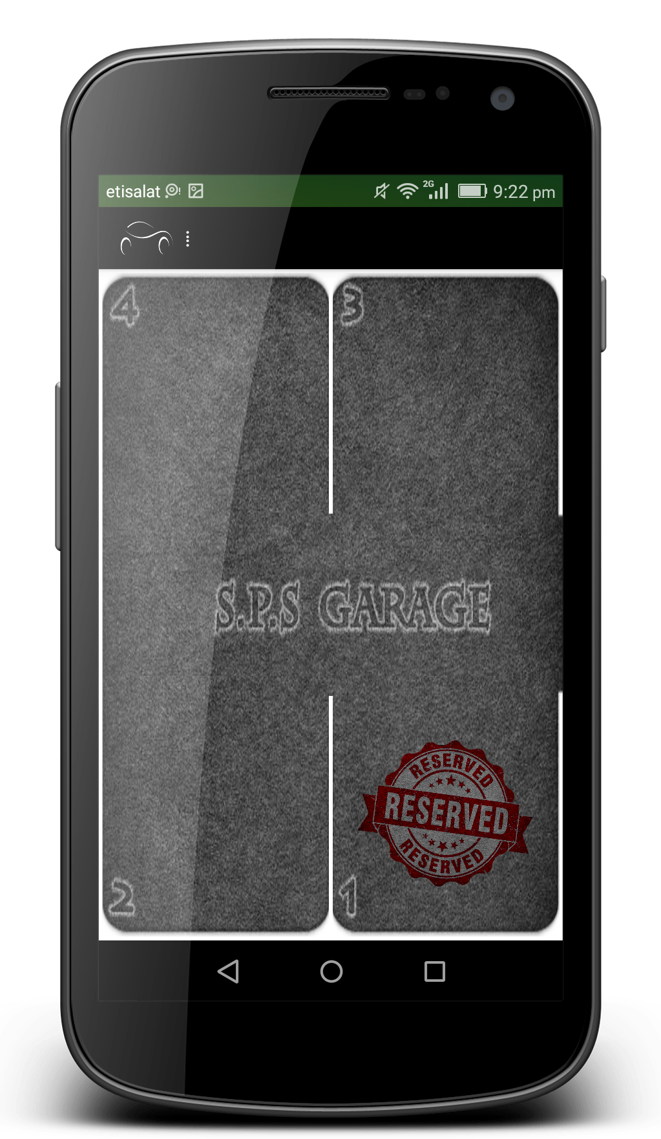
Layout2 (slot 1 is occupied)
- Layout programming procedures.

Slide 35
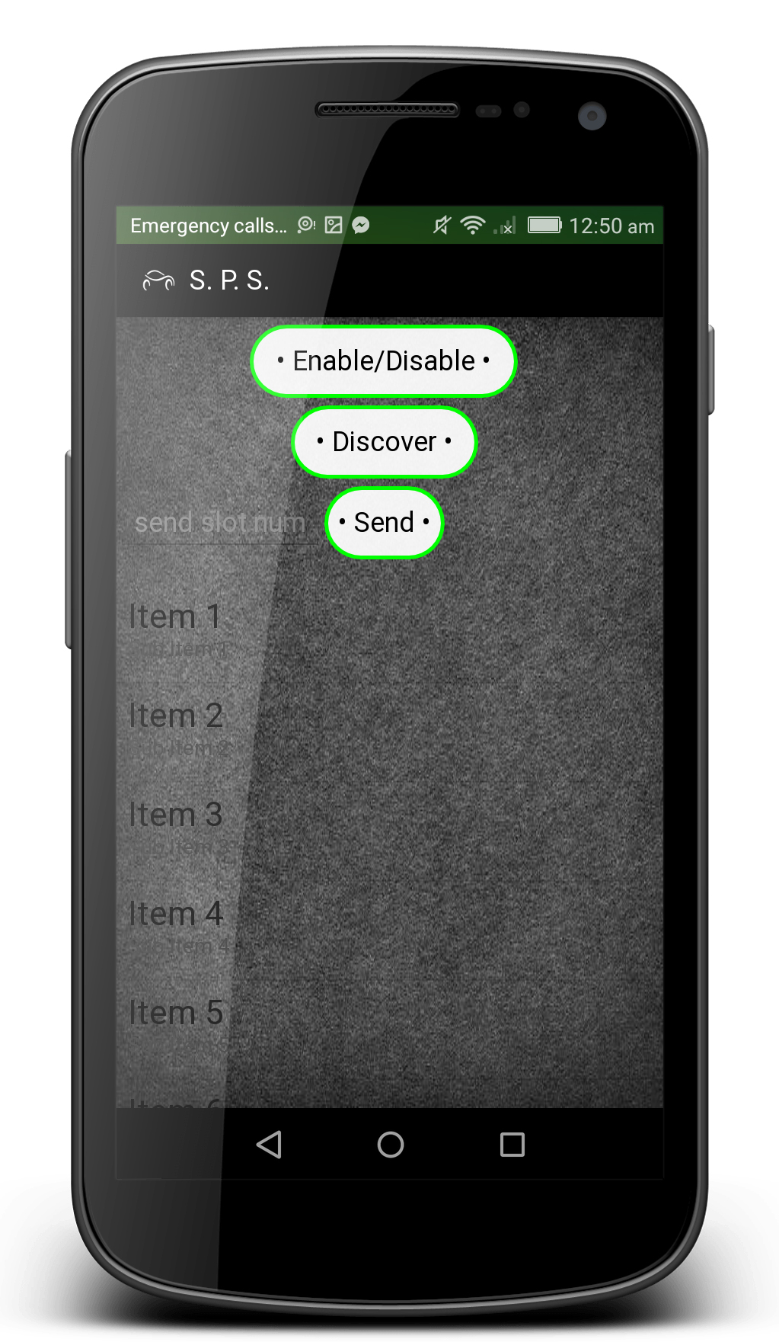
Layout3 (Bluetooth)
- Layout programming procedures.

Slide 36
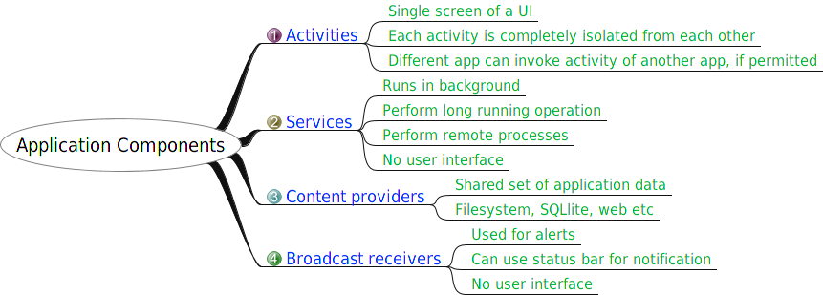
Main components of Android
.

Slide 37
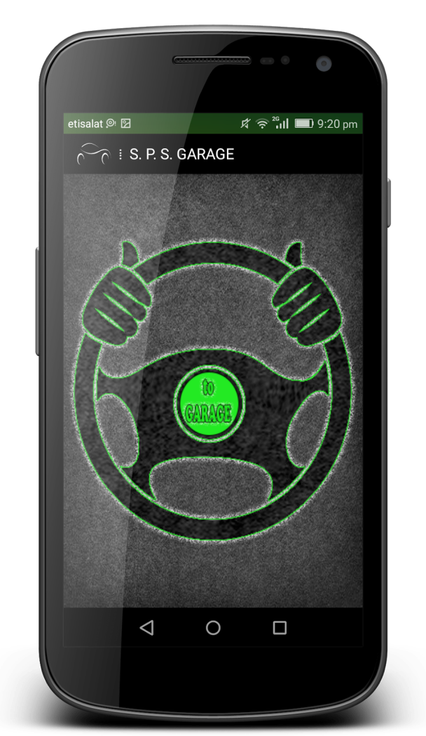
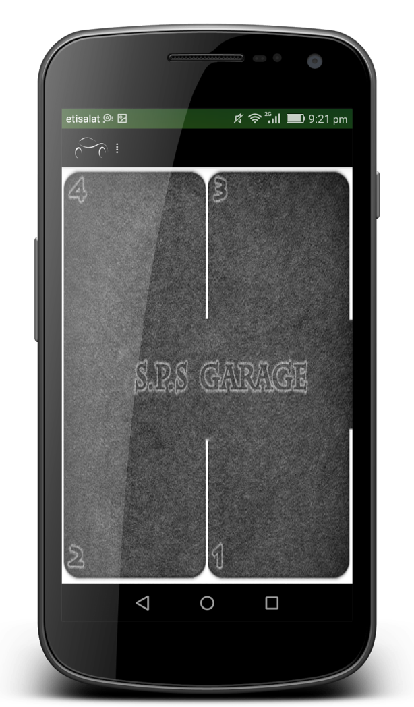
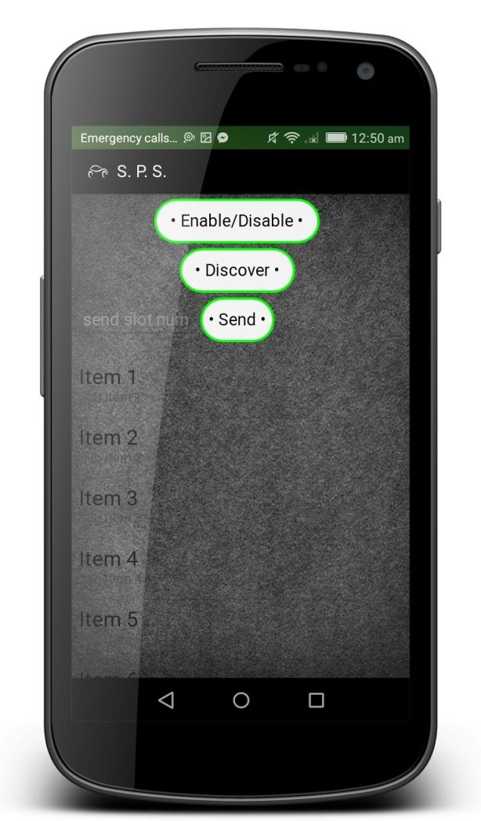
Activities and services
.

Slide 38
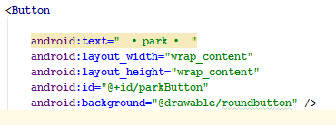
Declaration and Initialization
Declare objects in the beginning of the activity as a field.
Objects from XML initialized using findViewById() method.
Any other variable may be initialized in the method at which it is used at or in the onCreate() method.

Slide 39
SPS on create() method
OnCreate() as initialization method
Example
private Button ParkButton;
ParkButton = (Button) findViewById(R.id.parkButton);
2. setOnClickListener()
Fetching data (auto refreshing)

Slide 40
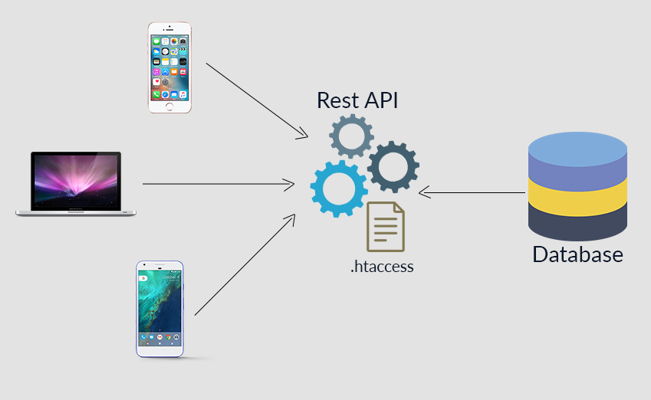
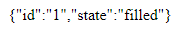
RESTful API and JSON
Application program interface that uses HTTP requests.
The data fetched is represented with JSON or XML .

Slide 41
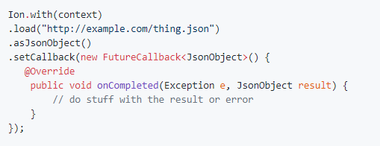
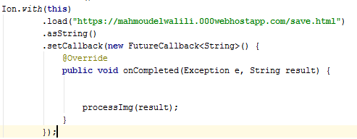
Ion library
Ion library is an Android asynchronous networking and image loading library.

Slide 42
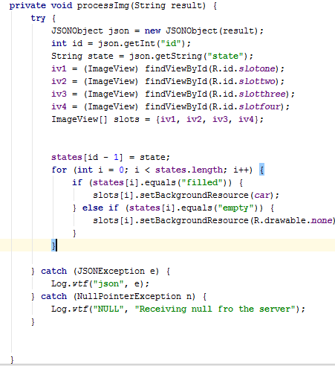

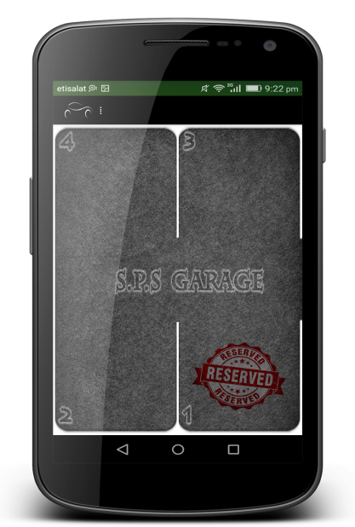
Data processing
Initialization of objects and variables.
Using simple algorithm to process the data.
Handling errors and throwing exceptions.

Slide 43
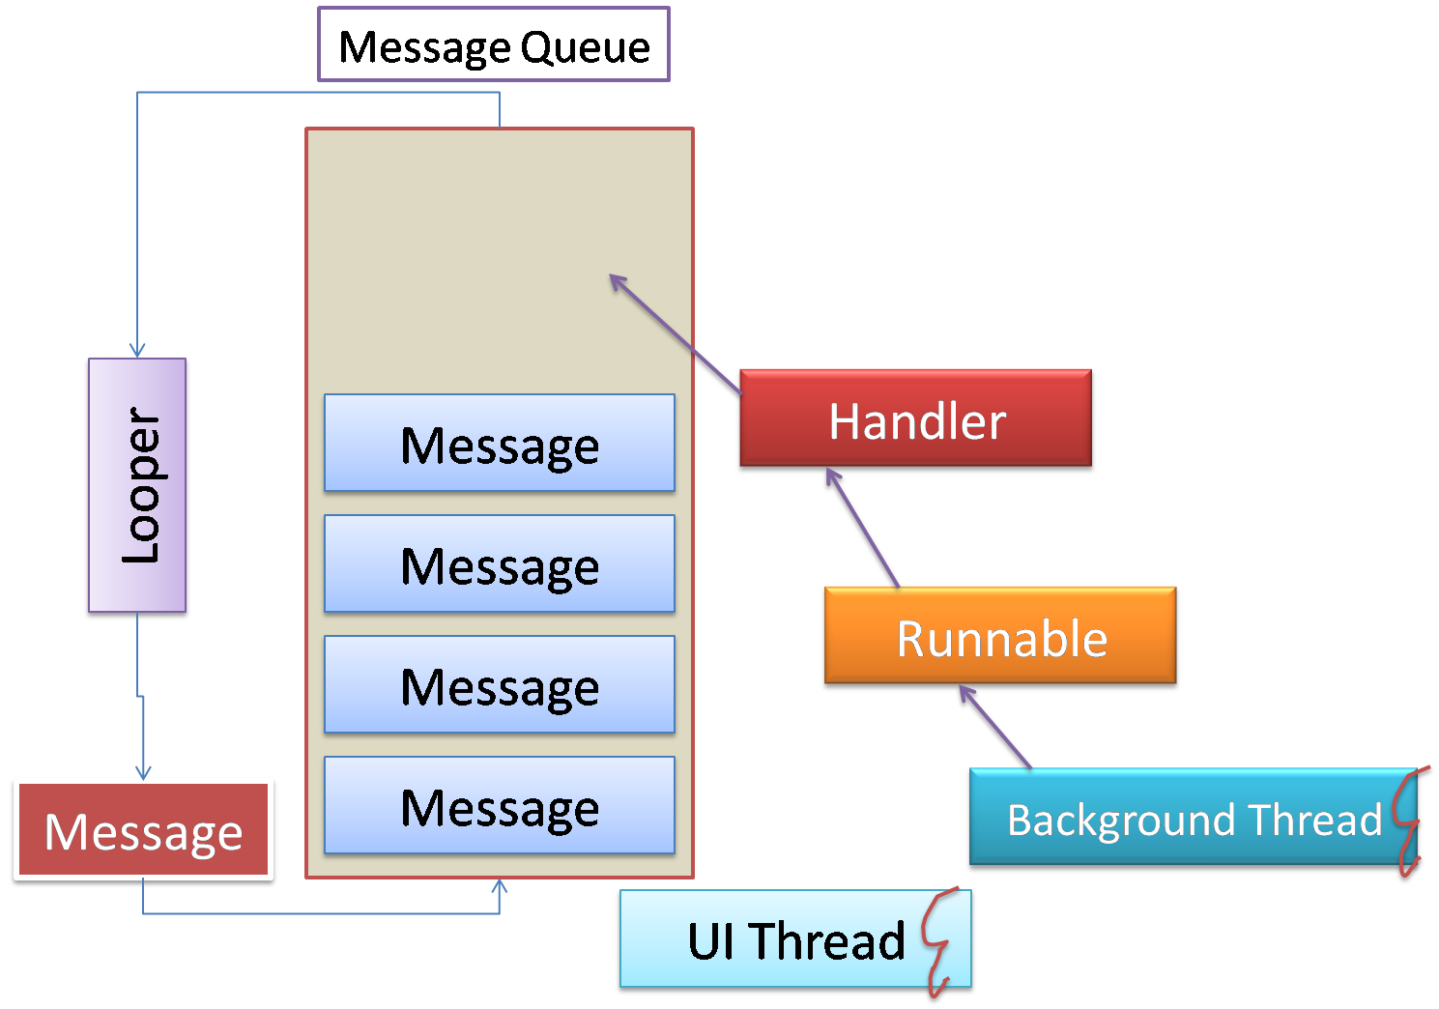
Auto refresh with handler
handler.postDelayed()
Runnable.
Time delay in milliseconds.

Slide 44
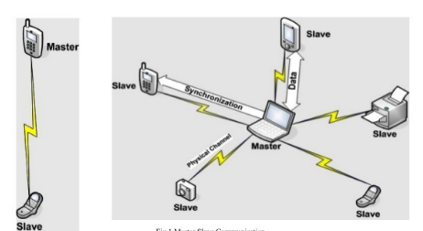
Bluetooth
Master-slave structure.
Secure channel .
Classes according to distance.

Slide 45
Android Bluetooth
Objects initialization
Bluetooth adapter
Bluetooth socket
Broadcast receivers
On enable/disable
On discovering devices
On changing bond state

Slide 46
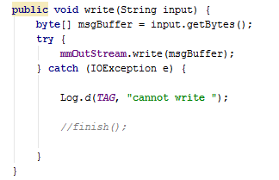
Bluetooth connection service
Start connected thread.
Input stream, output stream and buffer.

Slide 47
Self-Parking Robot
CAR-SIMULATED ROBOT DEMONSTRATION

Slide 48
Hardware Pieces
DC motors
Works as robot two-wheel drive.
Based on PWM for speed control.
Servo-steering mechanism
Ruling robot mobility in right and left directions.
DC motor driver
Protection and isolation from other circuit parts.
High current driving from external supply source.
Takes PWM, direction and circuit gnd as inputs and drives motor output.

Slide 49
TivaC Launchpad ARM architecture based
Widely used in industrial applications.
System clock speed up to 80 MHz .
Availability of advanced modules and peripherals.
Availability in market.
Bluetooth module
Plays the IoT role by making a connection between robot system and the mobile application.
Ultrasonic Sensor
It is object-distance detector, which returns parking slot space.
Based on timer.
IR Sensor
Object detection, which detects parking slot number based on a counter.

Slide 50
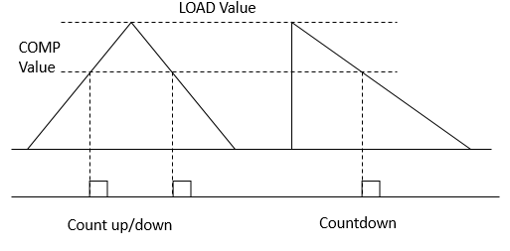
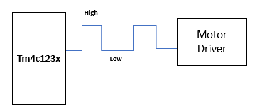
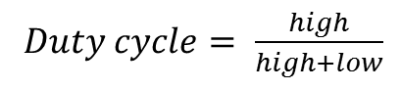
Hardware Interfacing
DC motors PWM interface
Maximum speed achieved by constant voltage source (no speed control) 100% duty cycle.
Variant pulse widths to achieve an appropriate speed in parking with variant duty cycles.
PWM module0 in TM4C123X to generate a variety of widths.
Initialize PORTB pin 4 and 5 as PWM alternative function.
Choose count up or count up/down mode and assign the required values.
$Duty cycle= \frac{high}{high+low}$

Slide 51
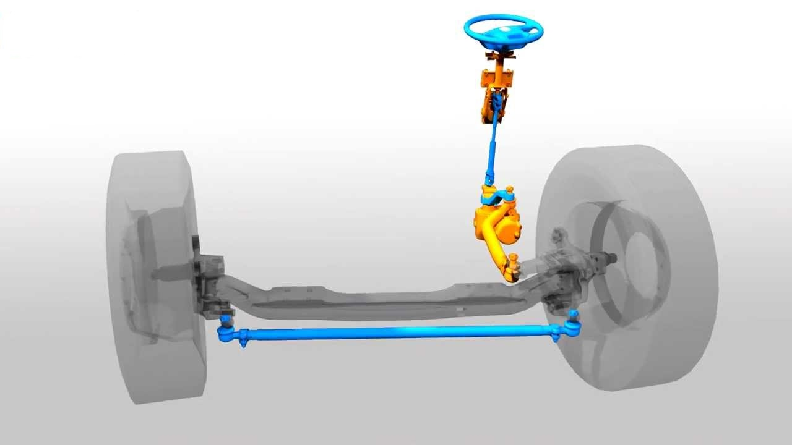
Servo-steering mechanism interface
Servo works with a pulse in total period.
PWM countdown mode is the best choice.
Initializations go as DC motor with different module.
Reused steering mechanism rather than designing a new one.
Repeated tests to get the best pulse duration for more accurate angles.

Slide 52
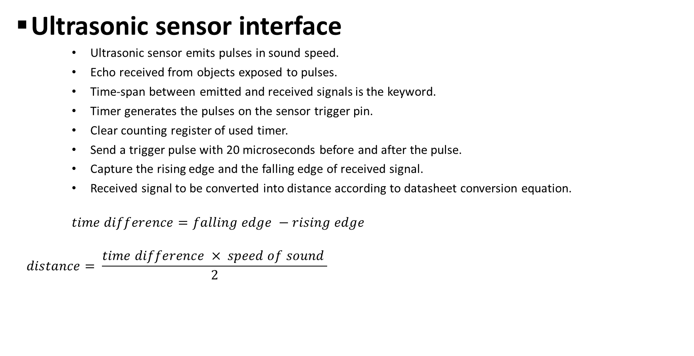
Ultrasonic sensor interface
Ultrasonic sensor emits pulses in sound speed.
Echo received from objects exposed to pulses.
Time-span between emitted and received signals is the keyword.
Timer generates the pulses on the sensor trigger pin.
Clear counting register of used timer.
Send a trigger pulse with 20 microseconds before and after the pulse.
Capture the rising edge and the falling edge of received signal.
Received signal to be converted into distance according to datasheet conversion equation.
$$time difference=falling edge −rising edge$$
$$distance= \frac{time difference × speed of sound }{2}$$

Slide 53
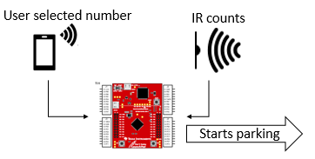
IR sensor interface
Plays the role of parking slot counter.
Microcontroller compares the returned counts with user selected number.
Parking process acts if there is a matching.
GPIO ports to operate IR sensor.
Initialize PORTE as GPIO.
One pin in use as input from sensor.
Software flag for non-repeated readings.

Slide 54
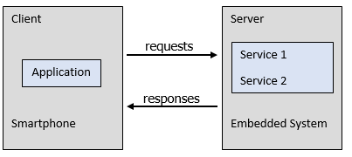
Bluetooth module interface
Plays the IoT connectivity role with the mobile application.
Mobile application is a client that requests a service.
Embedded system is a server that responds.
Peer-to-peer connection fits with UART protocol.
Initialize a UART module with 9600 baud rate.
UART interrupt.
Triggers software to start.
Better non-missing data reception.
Puts data in FIFO and rise flag in FR.
Received data to be compared with IR sensor counts.

Slide 55
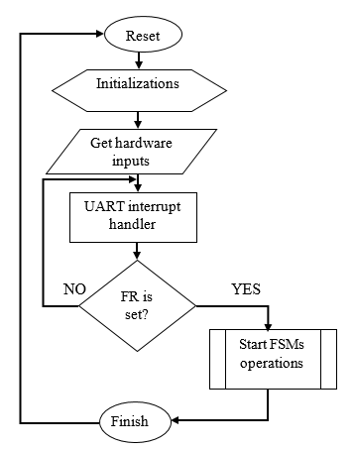
Software implementation
Software-implemented FSM
Final stage in written software.
Triggered by UART flag register.
Parallel parking based.
Divided into two state machines.
Parking slot detection.
Parallel parking.
Process starts with parking slot detection followed
by parallel parking.

Slide 56
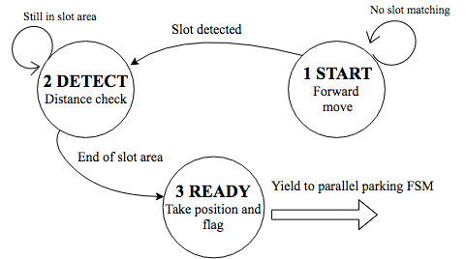
Parking slot detection FSM
Implemented by lookup table and linked list.
Predefined states for robot to go with.
START: Move forward until a slot is found.
DETECT: Find the boundary of detected slot.
READY : Position for parallel parking.

Slide 57
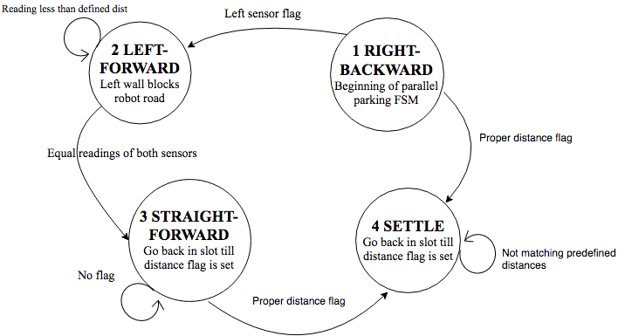
Perpendicular parking FSM
Implemented by lookup table and linked list.
Predefined states for robot to go with.
RIGHT-BACKWARD: Turn right and move back.
LEFT-FORWARD: If not settled, turn left and move forward.
STRAIGHT-BACKWARD : If sensors reading is equal.
SETTLE

Slide 58
Conclusion

Slide 59
Future work
WHAT IS NEXT

Slide 60
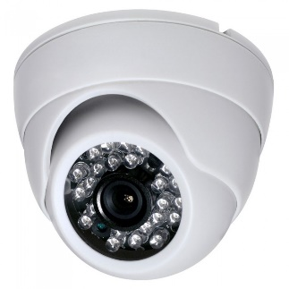
Future work
The future work is divided into three main parts
1- Improve the security:
Visual security system
By allowing visual security system in this project by using Closed Circuit Television (CCTV) cameras
which will provide real-time navigation and streaming .

Slide 61

Back-up database
Two separate database could be implemented on two separate hosts, one of them will be available to the user to use and made changes and the other one will be updated simultaneously.
The server in use called principal database.
The other server is called mirror database.

Slide 62

2- Improve the availability
Satellite navigation system technique could be used like GPS to help the user or car owner get offline services often there is no internet.
The navigational satellites are positioned in highly stable Medium Earth Orbits (MEOs) .
To determine your location accurately, the receiver need to receive four different signals from four different satellites at least and by measuring the time taken by the signal to travel from the satellite to the receiver antenna.

Slide 63


3- Improve the scalability
Making the algorithms effective to cover more parking spots.
Gathering many separate parking facilities in one cloud.
A network will be built as a backbone/infrastructure.
Pn is considered a car park on the network.
Dij is considered the distance between two car parks.
A function named $F\left(α;β\right)$ to calculate the cost between the nodes in the network.
$F_{ij}= F\left(α;β\right)= α X \frac{d_{ij}}{D_{up}}+ β X \frac{t_{j}}{T_{up}}$
$α is$ a coefficient depends on the path.
$β$ is a coefficient depends on the number of free slots.
Dup is the upper bound of the distance.
Tup is the upper bound of the capacity.

Slide 64


After calculations every car park will have all neighboring car parks information.
And the algorithm is used to determine which car park have the lower cost.

Slide 65
Thank You ☺

